Slide 1
Feature Selection in Machine Learning

Slide 2
Outline
The Need for Feature Selection
What is Feature Selection?
Feature Selection Methods

Slide 3
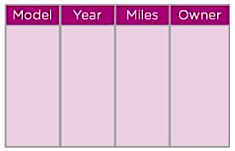
The Need for Feature Selection
To train a model, we collect huge quantities of data to help the machine learn better.
Consider a dataset which contains information on old cars.

Slide 4
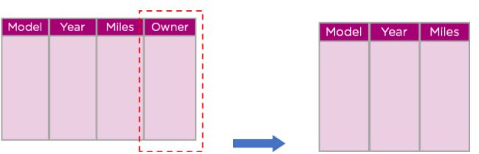
The Need for Feature Selection
But not all this data will be useful to us.
Some features or a part of the data may not contribute much to our model and can be dropped.

Slide 5
The Need for Feature Selection
In our data, a car will not be crushed based on its previous owner.
Here we have dropped the owner column as it does not contribute to the model

Slide 6

The Need for Feature Selection
Having too much unnecessary data can cause the model to be slow.
The model may also learn from this irrelevant data and be inaccurate

Slide 7

Outline
The Need for Feature Selection
What is Feature Selection?
Feature Selection Methods

Slide 8

What is Feature Selection?
Feature Selection is the process of reducing the input variable to your model by using only relevant data and getting rid of noise in data.

Slide 9
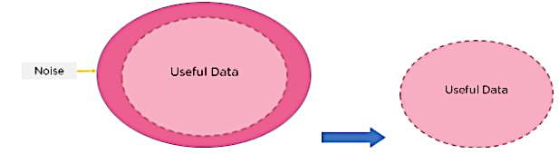
What is Feature Selection?

Slide 10

What is Feature Selection?
Using feature selection, we can optimize our model in several ways.
Prevent our model to learn from noise

Slide 11

What is Feature Selection?
Using feature selection, we can optimize our model in several ways.
Prevent our model to learn from noise
Improve model accuracy

Slide 12

What is Feature Selection?
Using feature selection, we can optimize our model in several ways.
Prevent our model to learn from noise
Improve model accuracy
Reduce training time

Slide 13
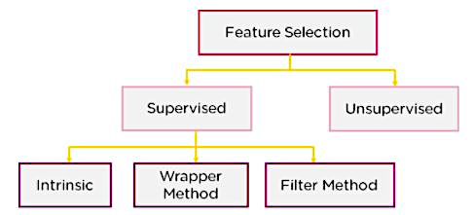
Feature Selection Methods

Slide 14
Outline
The Need for Feature Selection
What is Feature Selection?
Feature Selection Methods

Slide 15
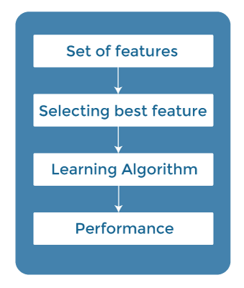
Filter Method
In this method, features are dropped based on their relation to the output, or how they are correlating to the output.
This method does not depend on the learning algorithm and chooses the features as a pre-processing step.

Slide 16
Filter Method
Examples are:
Information Gain
Chi-Square Test
Fisher’s Score
Pearson’s coefficients
ANOVA coefficient

Slide 17
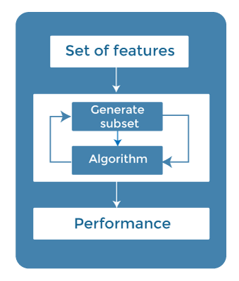
Wrapper Method
We split our data into subsets and train a model using this.
Based in the output of the model, we add and subtract features and train the model again.

Slide 18
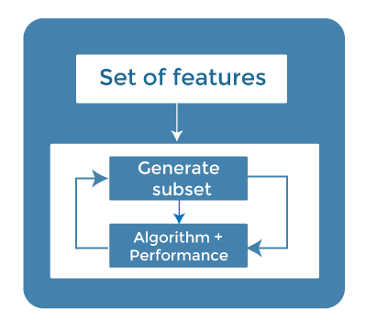
Wrapper Method
Examples are:
Forward Selection
Backwards Elimination
Recursive Feature Elimination

Slide 19
Wrapper Method Example
Consider the book dataset. By using wrapper method, we would use a subset of different features to train the model and adjust the subset according to output.
Name | No. of times read | Condition of Book | Color
… | … | … | …

Slide 20

Wrapper Method Example
Name | No. of times read | Condition of Book | Color
… | … | … | …
Output
ML Algorithm

Slide 21
Wrapper Method Example
Name≈ | No. of times read
… | …
Output
ML Algorithm

Slide 22
Wrapper Method Example
Condition of Book | Color
… | …
Output
ML Algorithm

Slide 23
Wrapper Method Example
Name | No. of times read | Condition of Book | Color
… | … | … | …
Depending on the output of the model, we will choose our final set of features
These features will give us the best result for our model
Name | No. of times read
… | …
Condition of Book | Color
… | …

Slide 24
Intrinsic/Embedded Method
In embedded methods, the feature selection algorithm is blended as part of the learning algorithm thus having its own built-in feature selection methods.
Feature selection is performed during the model training process.

Slide 25
Intrinsic/Embedded Method
The model will train and check the accuracy of different subsets and select the best among them.

Slide 26
Intrinsic/Embedded Method
Examples are:
Lasso and Ridge Regression
Decision Trees
Random Forest

Slide 27
References
https://www.javatpoint.com/feature-selection-techniques-in-machine-learning

